Slide 1

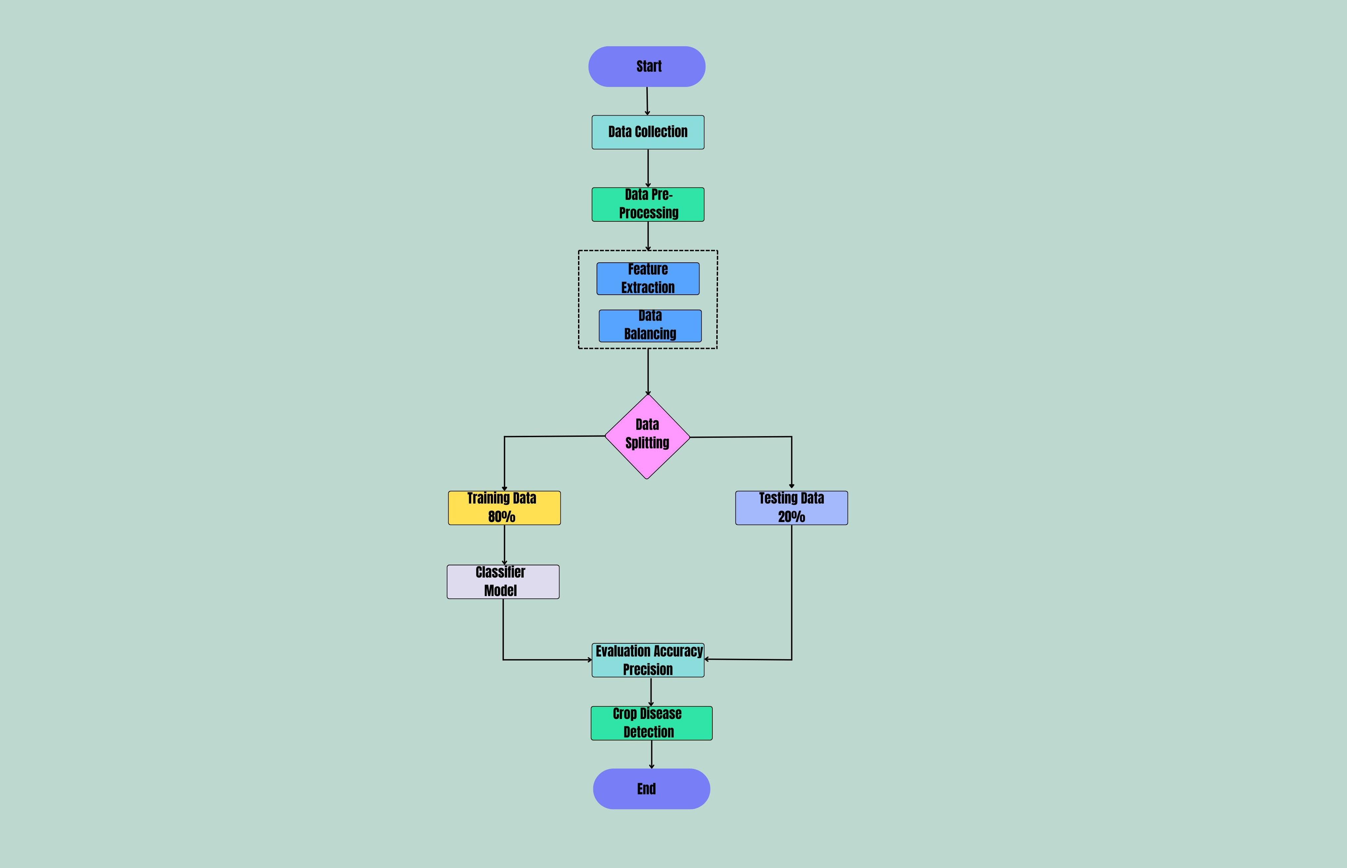
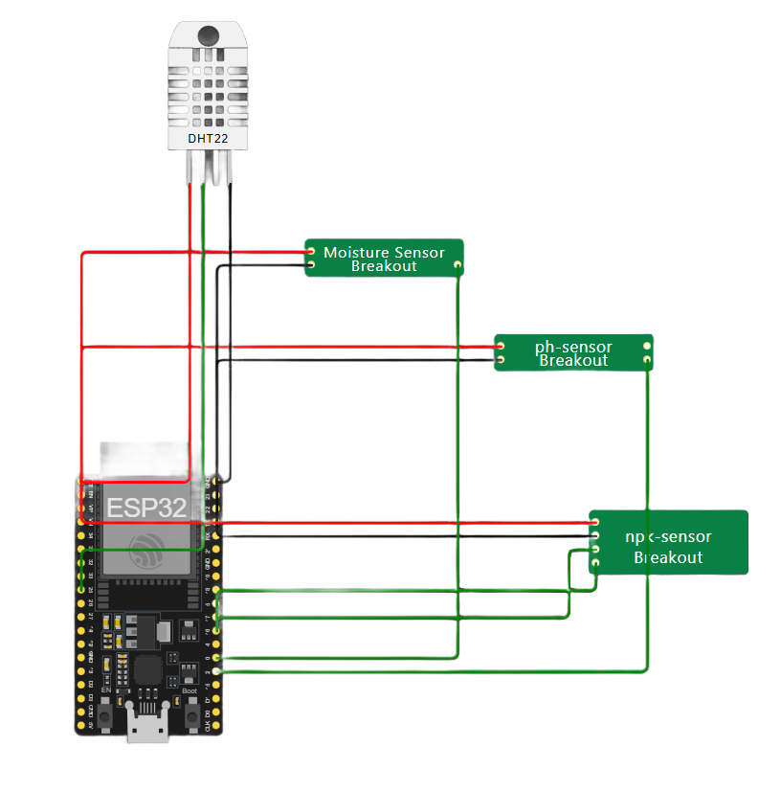
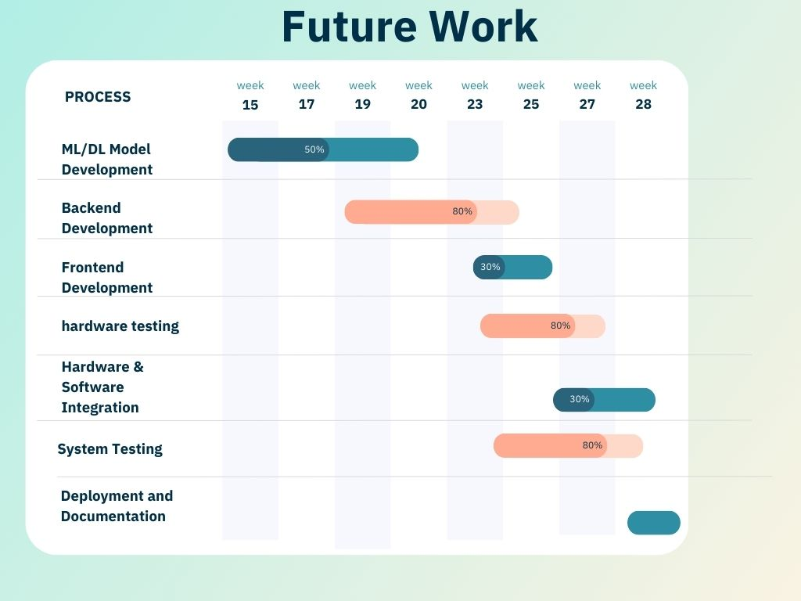
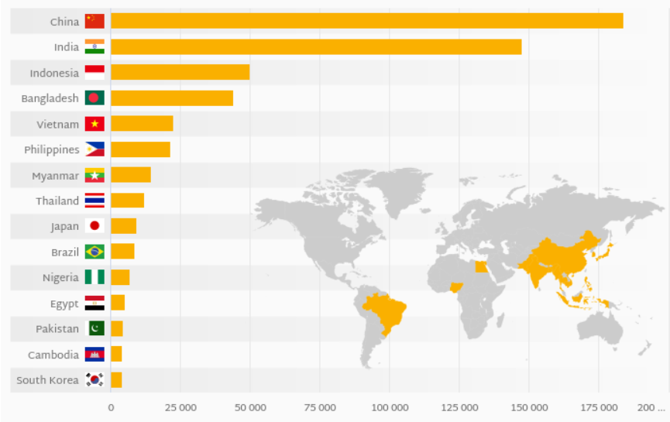
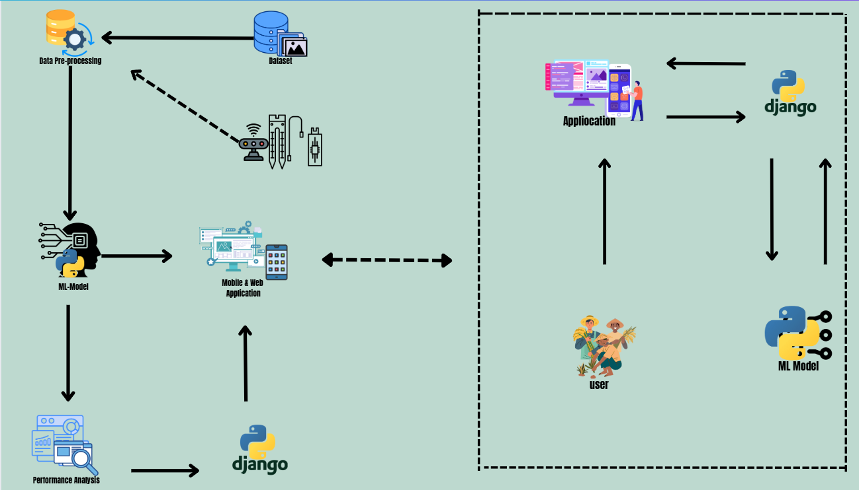
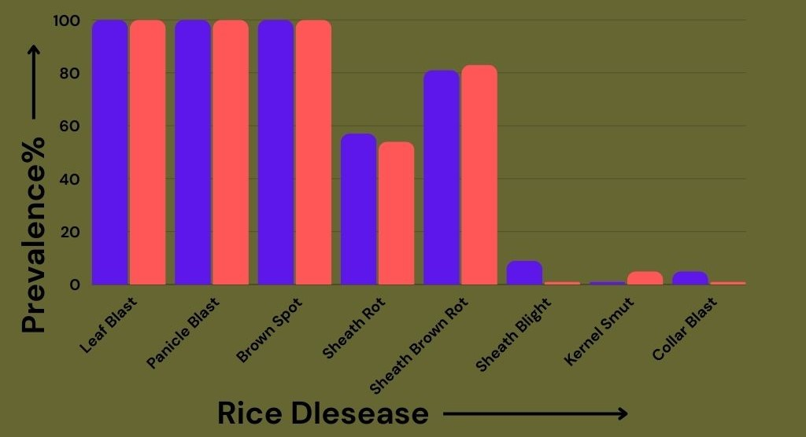
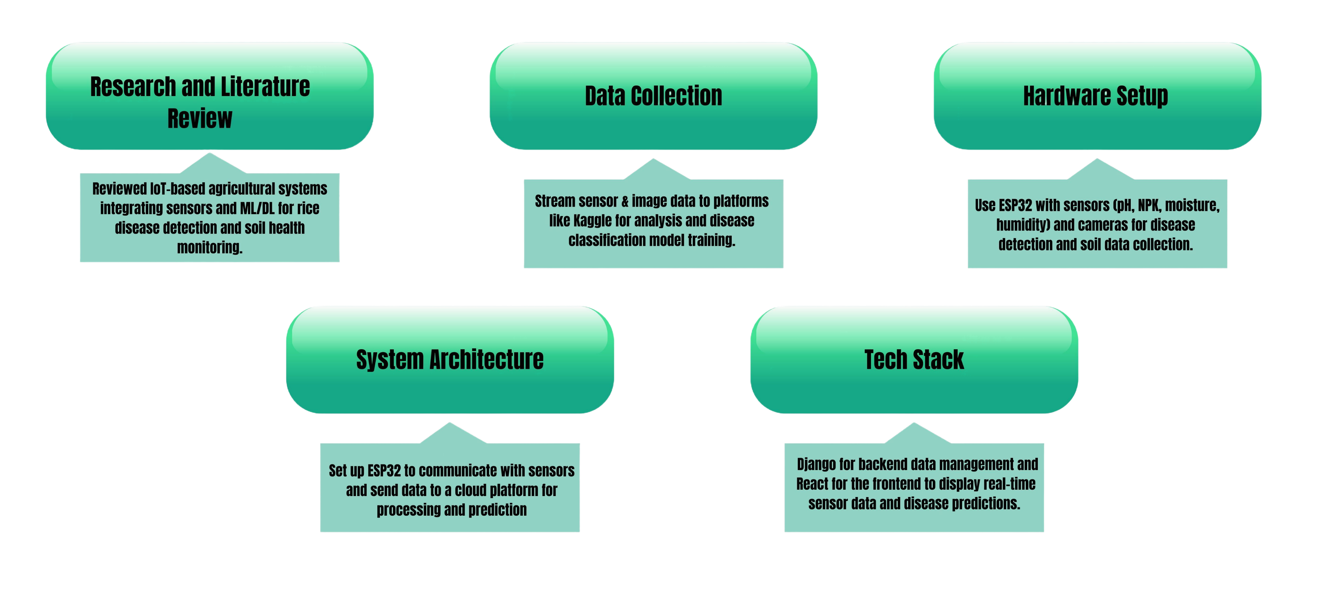


Rice Disease Detection Using ML & Soil Health Monitoring
Chayon Kumar Das(2001015) , Suvro Kumar Das(2001021)
Supervised by: MD.Toukir Ahmed , Lecturer dept. of IRE
Department of IoT and Robotic Engineering , UFTB
INTRODUCTION
Objectives
Proposed Methodology
Expected Outcome
Rice, a critical staple for over half of the global population, is highly vulnerable to diseases that diminish yield and threaten food security.[1-5] Manual detection methods are often inaccurate and impractical for large-scale agriculture. This project employs state-of-the-art image processing, machine learning (ML), and deep learning (DL) [1-5] techniques to automate disease diagnosis, improve precision, and enable real-time monitoring. By integrating soil health analysis[6], the system predicts whether the soil is suitable for rice cultivation and identifies nutrient deficiencies. The system utilizes Django for the backend and React for the frontend to ensure an efficient, scalable, and user-friendly platform.
Leverage image processing for automated identification of diseases such as Rice Blast, Sheath Blight, and Bacterial Blight.[1-5]
Monitor key soil elements (N, P, K, moisture, pH) using an ESP32-based IoT system.[6]
Implement a prediction model to assess whether the soil is suitable for rice cultivation and identify nutrient deficiencies.[1-5]
Develop a modular architecture with Django for backend and React for frontend, enabling scalability across various crops and geographies.
Promote precision agriculture by providing real-time feedback and predictive analytics to farmers.
Disease Classification Accuracy: Achieving over 95% classification accuracy for disease identification across diverse environmental conditions.[1-5]
Soil Health Prediction: Accurate prediction of soil suitability for rice, with real-time identification of nutrient deficiencies (NPK and pH).[6]
Deployment-Ready System: Diagnostic system with sub-second inference times for both disease identification and soil health prediction.
Scalable Architecture: A scalable solution with Django as the backend and React as the frontend, adaptable for use across different crops and regions.
Significant Impact: Reduction in disease-related losses and nutrient management optimization, enhancing economic sustainability for farmers.
Hardware Setup
Literature Review
Paper Name | Used Tools/Techniques | Achievement | Limitations
Rice Blast Disease Detection and Classification Using Machine Learning Algorithm [1] | Machine Learning (ANN), Image processing (color, morphology, texture) | 99% accuracy in training (infected leaves), 100% accuracy (healthy leaves), 90% accuracy in testing for infected leaves | Limited sample size (300 images), May not generalize well to other environmental conditions
Early-Stage Brown Spot Disease Recognition in Paddy Using Image Processing and Deep Learning Techniques[2] | Deep Learning (CNN), Image segmentation | 99.20% classification accuracy, Effective early-stage disease detection | Relies on high-quality images, limiting field use, Model performance may degrade with poor image quality
Detection of Bacterial Leaf Blight Disease Using RGB-Based Vegetation Indices and Fuzzy Logic[3] | UAV images, RGB-based vegetation indices (NGRDI, GLI), Fuzzy Logic | 90.16% accuracy in detecting BLB severity, Effective in mapping disease spread with UAV data | Requires UAVs for data collection, Sensitivity to environmental conditions affecting image quality
Deep Learning-Based Diagnosis of Rice Sheath Rot Disease: A Wavelet-Filtered Approach for Feature Extraction and Analysis[4] | Deep Learning (CNN), Wavelet filtering | 95% accuracy in diagnosing rice sheath rot disease, Improved model performance with wavelet filtering | High computational requirements, Limited to certain disease types
Automatic Disease Detection of Basal Stem Rot Using Deep Learning and Hyperspectral Imaging[5] | Deep Learning (VGG16, Mask RCNN), Hyperspectral Imaging | Average IoU of 0.8606 for segmentation, High classification accuracy for Basal Stem Rot detection | Requires hyperspectral imaging equipment, May not generalize well to other crop species
Problem Statement
System Architecture
Conclusion
This project leverages machine learning and soil health monitoring to automate rice disease detection and nutrient analysis with over 95% accuracy. Its scalable design, using Django and React, enables real-time insights and adaptability for various crops. By optimizing resource use, it promotes precision agriculture and economic sustainability.
Working Progress
Key Features
Automated Disease Diagnosis
Soil Health Prediction
Advanced Image Analytics
Django Backend
React Frontend
Data-Driven Insights
REFERENCES

